Slide 1
Before reuse
Slides that need pictures:
4&5 What do Workflows Provide
6 Workflow – Push and Pull
9 A bit about JIRA
11 Workflows in JIRA
26 Sub Tasks
18 Needs arrows lining up
General improvements
More notes on what happens in each stage
Specific what can be determined because of that
Integration?

Slide 2
Sample Tracking with JIRA
Peter Edworthy

Slide 3
Workflows

Slide 4
What do Workflows provide?
Workflows define a process
Consistent
Sets Expectations
Repeatable
Workflows capture the dynamic state of a process
Reports / Prediction
Avoid missed samples
Start
Finish
End
Start Again

Slide 5
What do Workflows provide?
Route/Pass information
Subsuming forms
Generate an Audit Trail
Return Months or Years later
Start
Finish
End
Start Again

Slide 6
Workflow – Push and Pull
Push
The current issue owner assigns the next issue owner
Issues always have an owner
Pull
Issues are assigned to self
Issues may be waiting for an owner
Start
Finish
End
Start Again

Slide 7
Workflow – Open and Restricted
Open
Few restrictions on the order that states can be visited in
Produces a large list of possible transitions for each step.
Restricted
Only a limited set of transitions are available
Some steps can only be reached by multiple transitions, if at all
Start
Fail
Finished

Slide 8
Workflows in JIRA

Slide 9
A bit about JIRA
'Issue'
JIRA's central concept
Each sample is an issue
Issues have a 'status', a 'resolution' and an 'Assignee'
Issues can also have 'custom fields' such as Charge Code
'Sub-Tasks'
Issues that only exist within another, larger, issue.
Start
Finish
End
Start Again

Slide 10
Workflows in JIRA
'Steps'
The building blocks of workflows
A status is associated with each step.
'Transitions'
Link the steps
Start
Finish
End
Start Again

Slide 11
Workflows in JIRA
'Transition Conditions'
control if a transition is available
'Validators'
can check fields when a transition is attempted
'Post-Functions'
are triggered once a transition has occured
Start
Finish
End
Start Again

Slide 12
Influenza Pipeline

Slide 13
Received Sample
Lab Processing
Close Sample
Too Few
Needs Edits
Sanger Sequencing
Sanger Sequencing
Next Gen Sequencing
RT_PCR
Lab workflow
Next Gen Sequencing
In House Closure Task
In House Closure Workflow
Custom Closure Task
Custom Closure Workflow
Open
SISPA
Lab workflow
Open
Open
Open
Too Few
Design Primers
Fail
Complete
Fail
Complete
Perform Reactions
Order Primers
Closure Edit Task
Closure Workflow
Perform Reactions
Open
Complete
Complete
Complete
Complete
454 Sequencing
Illumina Sequencing
Sequencing Task
Lab workflow
Sequencing Inc Library Construction
Lab workflow
Sequencing Task
Lab workflow
Sequencing Task
Lab workflow
Complete
Open
Open
Open
Open
Fail
Complete
Fail
Complete
Fail
Complete
Requires Closure
Now Complete
Fail
Complete
All sub-tasks complete
Assembly
Review Assembly
Collaborator Review
Major problems
Complete
Fix gaps and minor errors
Validate for Submission
Deliver Data
45 day wait
Sample Published
Unresolved
Deprecated

Slide 14
Steps

Slide 15
Received Sample
Lab Processing
Assemble
Close Sample
Sample Deprecated
Review Assembly
Unresolved
Validate for Submission
Collaborator Review
Deliver Data
Sample Published

Slide 16
Received Sample
Lab Processing
Assemble
Close Sample
Sample Deprecated
Sample Deprecated
Review Assembly
Unresolved
Unresolved
Validate for Submission
Collaborator Review
Deliver Data
Sample Published

Slide 17
Received Sample
Lab Processing
Lab Processing
Assemble
Close Sample
Sample Deprecated
Sample Deprecated
Review Assembly
Unresolved
Unresolved
Validate for Submission
Collaborator Review
Deliver Data
Sample Published

Slide 18
Received Sample
Lab Processing
Assemble
Assemble
Close Sample
Sample Deprecated
Sample Deprecated
Review Assembly
Unresolved
Unresolved
Validate for Submission
Collaborator Review
Deliver Data
Sample Published

Slide 19
Received Sample
Lab Processing
Assemble
Close Sample
Sample Deprecated
Sample Deprecated
Review Assembly
Review Assembly
Unresolved
Unresolved
Validate for Submission
Collaborator Review
Deliver Data
Sample Published

Slide 20
Received Sample
Lab Processing
Assemble
Close Sample
Sample Deprecated
Sample Deprecated
Review Assembly
Review Assembly
Unresolved
Unresolved
Collaborator Review
Validate for Submission
Collaborator Review
Validate for Submission
Deliver Data
Deliver Data
Sample Published

Slide 21
Received Sample
Lab Processing
Assemble
Close Sample
Sample Deprecated
Sample Deprecated
Review Assembly
Unresolved
Unresolved
Validate for Submission
Collaborator Review
Deliver Data
Deliver Data
Sample Published

Slide 22
Received Sample
Lab Processing
Assemble
Close Sample
Sample Deprecated
Sample Deprecated
Review Assembly
Unresolved
Unresolved
Validate for Submission
Collaborator Review
Deliver Data
Sample Published
Sample Published

Slide 23
Received Sample
Lab Processing
Assemble
Close Sample
Close Sample
Sample Deprecated
Sample Deprecated
Review Assembly
Unresolved
Unresolved
Validate for Submission
Collaborator Review
Deliver Data
Sample Published

Slide 24
Received Sample
Lab Processing
Assemble
Close Sample
Sample Deprecated
Sample Deprecated
Review Assembly
Unresolved
Unresolved
Collaborator Review
Validate for Submission
Collaborator Review
Deliver Data
Sample Published

Slide 25
Sub Tasks

Slide 26
Sub Tasks
For activities that are:
Optional
Repeatable
  Store multiple data sets

Slide 27
Closure Edit Workflow
Used for:
Closure Edit Tasks
Open
Open
Complete

Slide 28
Custom Closure Workflow
Used for:
RT PCR
SISPA
Sequencing
Open
Fail
Complete

Slide 29
Custom Closure Workflow
Used for:
Custom Closure Tasks
Open
Open
Design Primers
Order Primers
Perform Reactions
Perform Reactions
Complete
Complete

Slide 30
In-House Closure Workflow
Used for:
In-House Closure Tasks
Open
Perform Reactions
Complete

Slide 31
JIRA Features

Slide 32
Search

Slide 33
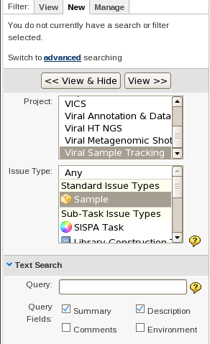
Search
Search forms the basis for much of JIRAs advanced functionality
Text Search
  Limited to certain fields
  Requires knowledge of terms used
Advanced Functions
Wildcard Searches: ? and *
Fuzzy Searches: ~
Proximity Searches: ~#
Boosting a Term: ^
Boolean Operators: AND, OR
Required / Exclude term: + / -
Grouping

Slide 34
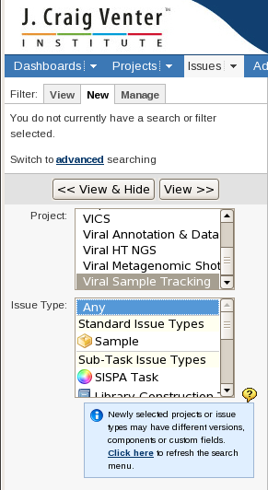
Surprises
Searching
  X will work
  X will not work
  X will or won't
Search: “X will work” returns
  X will work
  X will not work
Search: “X will not work” returns
  X will work
  X will not work
Search: “X will” NOT “work” returns
  X will or won't

Slide 35
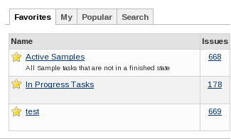
Filters
The base method of selection, used in nearly every part of JIRA
Extends searching to allow field by field restrictions
Filters are:
  Saveable
  Shareable

Slide 36
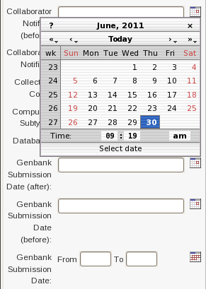

Filtering by Field
The method of filtering depends on the type of information the column contains
Text
The normal search is used
Date
Specific dates can be set
Ranges, between two dates
Open Ranges, after X / before Y

Slide 37


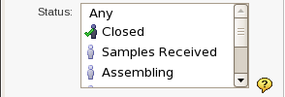
Filtering by Field
Numbers
  Specific values
  Ranges
  Open Ranges
Select
  None or One value from a list of options
Multi-Select
  None, One or More values from a list

Slide 38
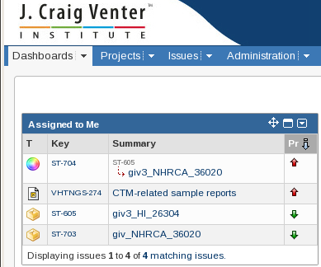
Using Filters
  Displaying in the Issue Navigator
  Displaying in a Dashboard
  To setup a regular email
  To produce a Graph or Report

Slide 39
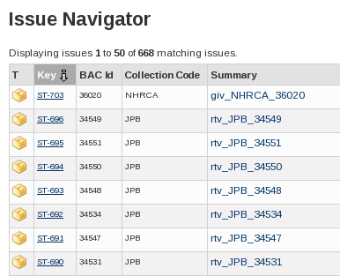
Issue Navigator
Displays the Issues in a table. Rows are Issues and the columns are information held on them.
Columns
  Customizable, saved with search
  Results can be ordered by any column
  Results can be filtered using the columns

Slide 40
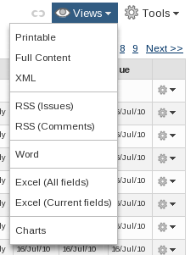
Issue Navigator
  Export
  Supports Multiple Filetypes
  Excel
  Word
  RSS
  XML
  To the charting feature

Slide 41
Reports

Slide 42

Standard Reports
  Workload Pie Chart
  User Workload
  Single Level Group By
  Created vs Resolved Issues
  Resolution Time
  Pie Chart
  Average Age
  Recently Created Issues
  Time Since Issues

Slide 43
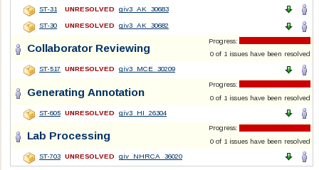
Single Level Group By
Produces a series of tables,
one per value from the
'Group By' field
Example
Filter by all Issues that have:
  Status = 'Open'
  Project='Sample Tracking'
Group By
  Status

Slide 44
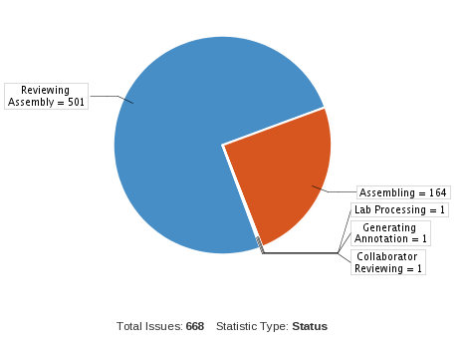
Pie Chart
Counts the number of issues per value of 'Statistic Type'
Each wedge represents that number divided by all the issues in the filter
Example
Filter
All Issues that have:
  Status = 'Open'
  Project='Sample Tracking'
Group By / 'Statistic Type'
  Status

